Slide 1
Deep Learning pipeline for Automatic Speech Recognizer
Koushik Kumar Kamala
Mrunali Sanjay Khandat

Slide 2
What is Speech?
Speech is human vocal communication using language. [1]
Speech conveys expressions, thoughts, emotions and anything that a human being wants the other human being to know.
Grammar has been established in every language for effective use of language to articulate thoughts via speech.
Grammar for every language forms a systematic way of speaking to convey thoughts meaningfully and understandably.
The systematic way of speaking makes it predictable.

Slide 3
Speech Recognizer
According to Wikipedia, Speech recognition is an interdisciplinary subfield of computational linguistics that develops methodologies and technologies that enables the recognition and translation of spoken language into text by computers. [2]
It is also known as automatic speech recognition (ASR), computer speech recognition or speech to text (STT). [2]
Speech Recognition systems have been widely in use by various Voice Assistants like Siri, Alexa to facilitate user. The speech recognition part plays a vital role if it is embedded in a system that performs further tasks based on recognized speech.

Slide 4
Motivation
As mentioned earlier, Speech Recognition is used as a base for more services to the end user such as voice user interfaces, speech to text processing
The errors in the use of next services can be reduced exponentially if speech is recognized with least Word Error Rate (WER)
More Speech Recognition based services can be launched if WER is reduced in current Speech Recognizer models.

Slide 5
Literature Review
In this research paper, Recurrent Neural Network approach is used in end-to-end automatic speech recognition (ASR) [4]
The paper tests the built model on various datasets like Wall Street Journal dataset (WSJ), LibriSpeech and VoxForge, CHiME
The models outperform human WER for the read datasets like WSJ and LibriSpeech
Low latency for system distributed online is achieved in the paper with Batch Dispute technique using GPUs
Link to the research paper- http://proceedings.mlr.press/v48/amodei16.pdf

Slide 6
Literature Review
This research paper by Daniel Povey focuses on comparison between Wall Street Journal trained speech recognition corpus and LibriSpeech trained speech recognition corpus using Word Error Rate [3]
For training purposes, text data is aligned with the speech using language models to get small snippets of audio along with the text
Using the data prepared by the study, Deep Learning Neural Networks can be used to improve speech recognition
Link to the research paper- LIBRISPEECH: AN ASR CORPUS BASED ON PUBLIC DOMAIN AUDIO BOOKS Vassil Panayotov, Guoguo Chen∗, Daniel Povey∗, Sanjeev Khudanp

Slide 7
Problem Statement
Task
Building Speech Recognizer for English Language audio
Performance
Evaluation of model based on CTC loss
Experience
Using LibriSpeech segmented and aligned data for audio books

Slide 8
Dataset
The dataset consists is derived from LibriSpeech
A corpus of 1000 hours of 16kHz read English speech
Carefully segmented and aligned data [1]
Link to dataset- http://www.openslr.org/12/

Slide 9
Data Characteristics
dev-clean, test-clean - development and test set containing "clean" speech.
train-clean-100 - training set, of 100 hours of "clean" speech
train-clean-360 - training set, of 360 hours of "clean" speech
dev-other, test-other - development and test set, with speech which was automatically selected to be more "challenging" to recognize
train-other-500 - training set of approximately 500 hours containing speech that was not classified as "clean", for some (possibly wrong) reason

Slide 10
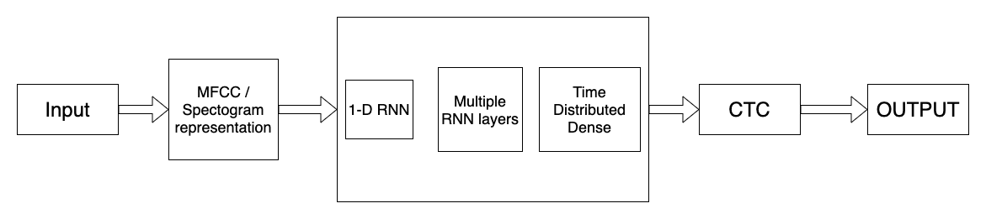
Architecture
Block Diagram of the implemented architecture

Slide 11
Data Pre-processing
Using the training and validation audio features, created a directory to know which folder holds which recording exactly
Converted the audio from .flac to .wav

Slide 12
Data Pre-processing
Feature Extraction:
The Audio features from the dataset are extracted by the following techniques:
MFCC
Spectrogram

Slide 13
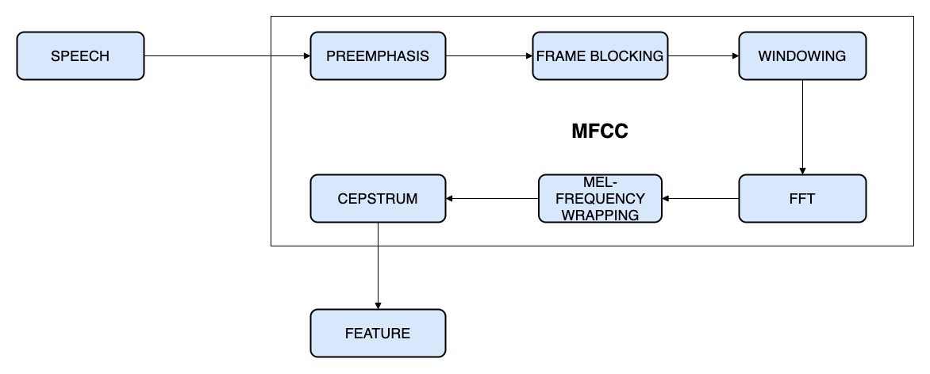
MFCC
Block Diagram of MFCC

Slide 14
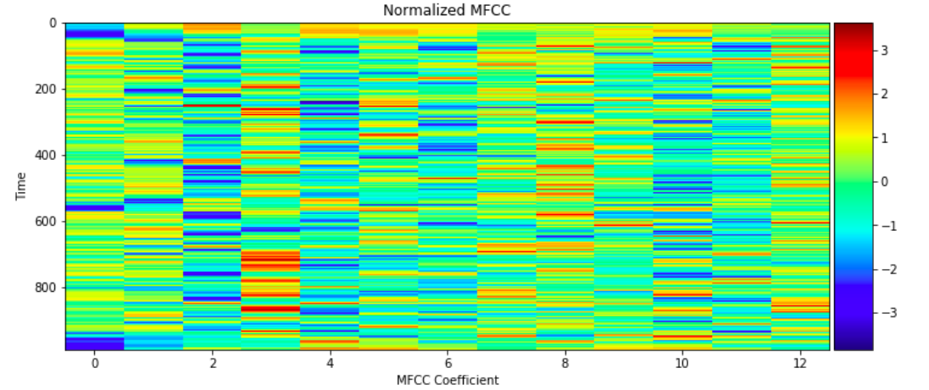
MFCC Coefficient

Slide 15
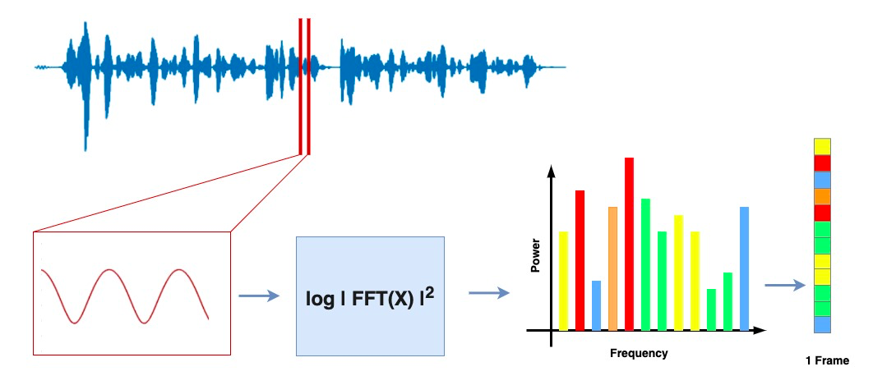
Spectrogram

Slide 16
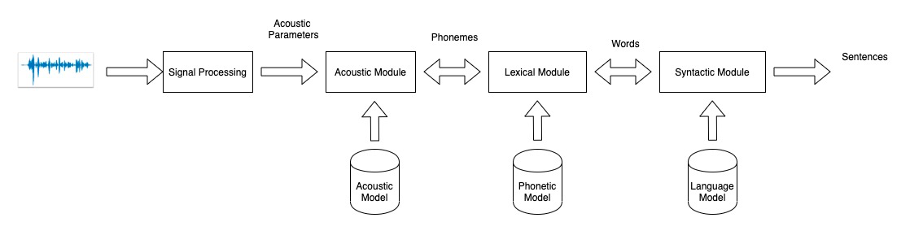
Acoustic Model

Slide 17
Performance Metrics
Connectionist Temporal Classification (CTC) Loss
Used for training recurrent neural networks (RNNs) that deal with sequence problems
CTC loss function - Training
CTC decode function - Output
Implemented the ctc_loss function from Tensorflow

Slide 18
Common components used in RNN architecture
Activation Function
Optimizers
Hyperparameter tuning and
Models and layers

Slide 19
Activation Functions
ReLu Activation:
Linear function which evaluates the function $f(x)=max(0,x)
Outputs the input only if the input is positive else zero.
Easy training
Better performance
Default activation function
Softmax Activation:
To normalise the scores into a vector of values (probabilities)

Slide 20
Optimizers and Hyperparameter tuning
Batch Normalization:
Initializes neural networks by explicitly forcing the activations
Implemented after the Dense or convolutional layers.
Makes the network significantly robust to lousy initialization.
Greatly decreases the ability of a small number of external inputs to over-influence the training thereby
Reduces the overfitting.

Slide 21
Optimizers and Hyperparameter tuning
TimeDistributedDense:
A fully-connected layer generally used before output
Keeps one-to-one relations between input and output
It avoids interaction between two time series signals with different timesteps
This helps in not flattening the RNN output

Slide 22
Hyperparameter Tuning
Hyperparameters :
Number of filters
Kernel size
Number of units

Slide 23
Models & Layers
General layers used in any RNN model
Recurrent layer- GRU/ LSTM
Normalization- BatchNormalization
Dense layer- TimeDistributedDense
Activation function- softmax
All the models are trained for 20 epochs
Input: Time series signals of audio features
Output: A vector of probabilities with 29 probabilities
The 29 values imply 26 alphabets, a space, an apostrophe and an extra empty character used for padding
Maximum probability vectors are then decoded as output

Slide 24
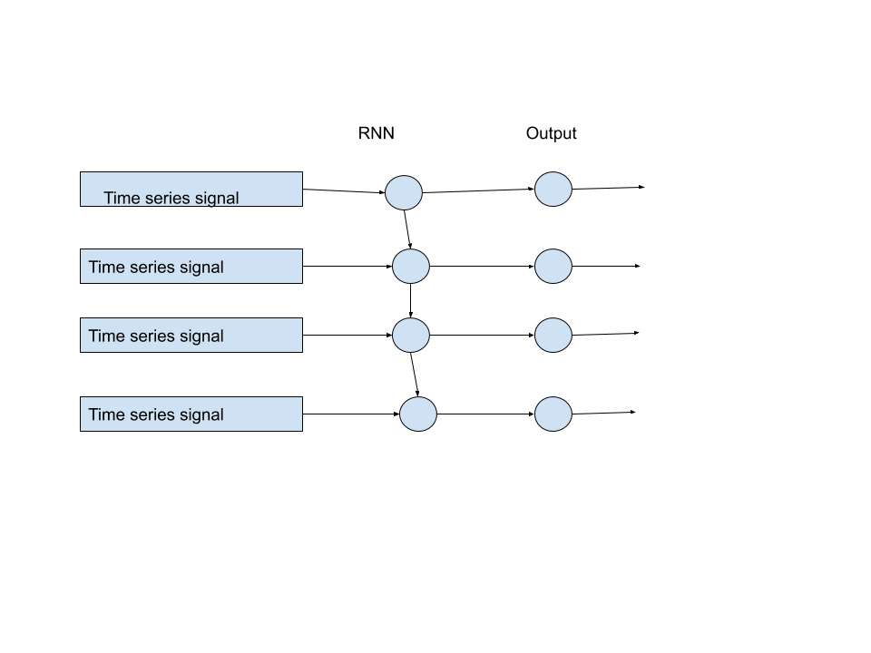
Simple RNN model

Slide 25
Simple RNN Model
Components of the model-
Recurrent layer using GRU
Activation function
Training loss: 752.9468
Validation loss obtained: 681.1827

Slide 26
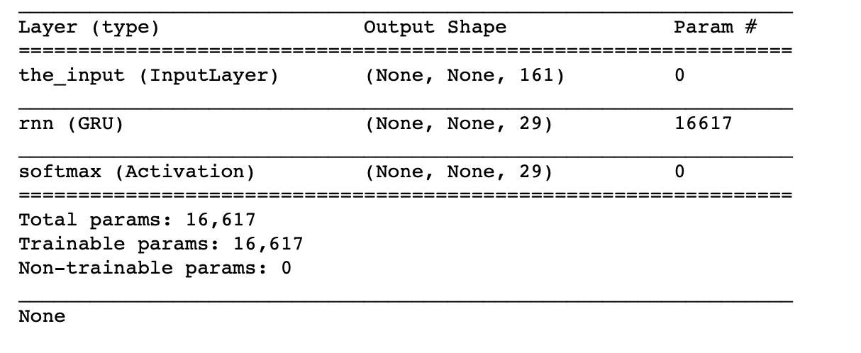
Simple RNN Model

Slide 27
RNN model with normalization
Components of the model-
Recurrent layer using GRU
BatchNormalization
TimeDistrbutedDense
Activation function
Training loss: 127.96
Validation loss: 129.05

Slide 28
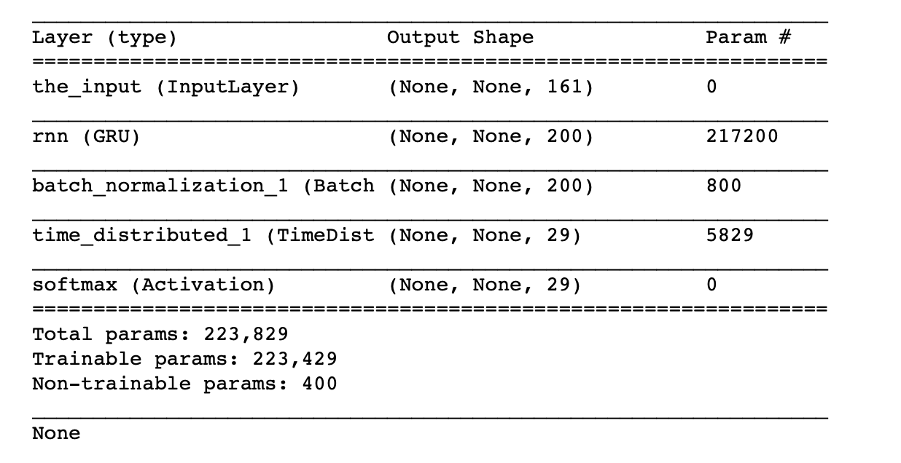
RNN model with normalization

Slide 29
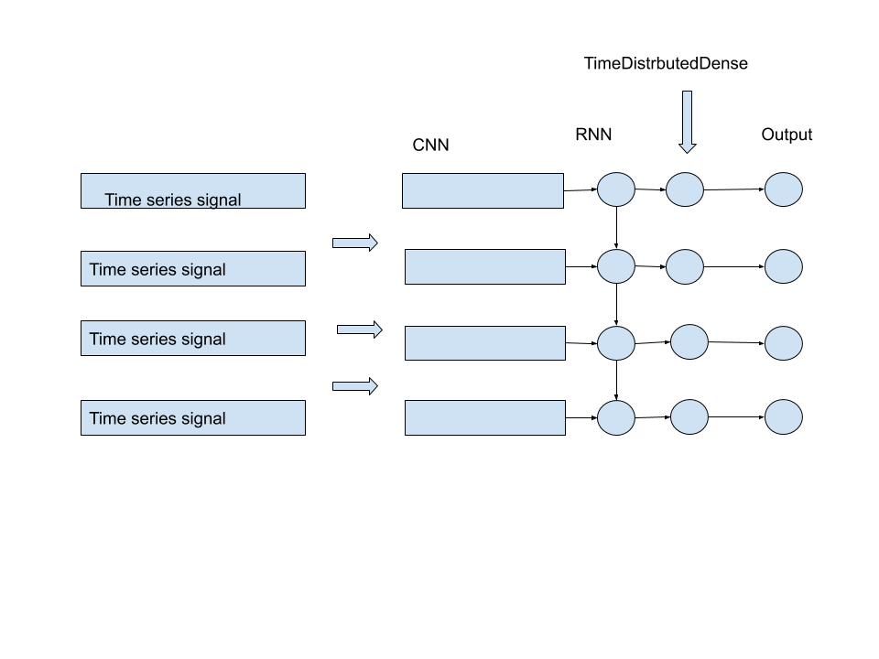
CNN-RNN model

Slide 30
CNN-RNN model
Components of the model-
CNN layer
Recurrent layer using GRU
BatchNormalization
TimeDistrbutedDense
Activation function
Training loss: 94.53
Validation loss: 155.36

Slide 31
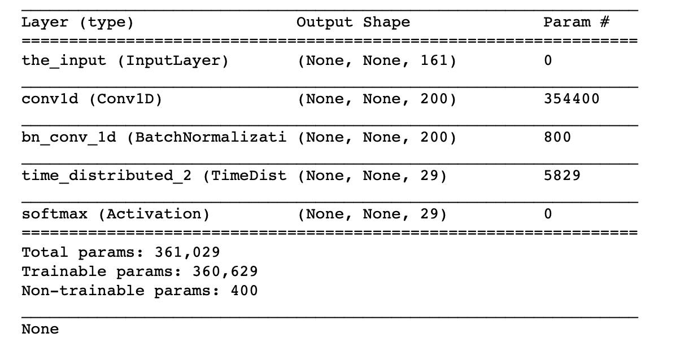
CNN-RNN Model

Slide 32
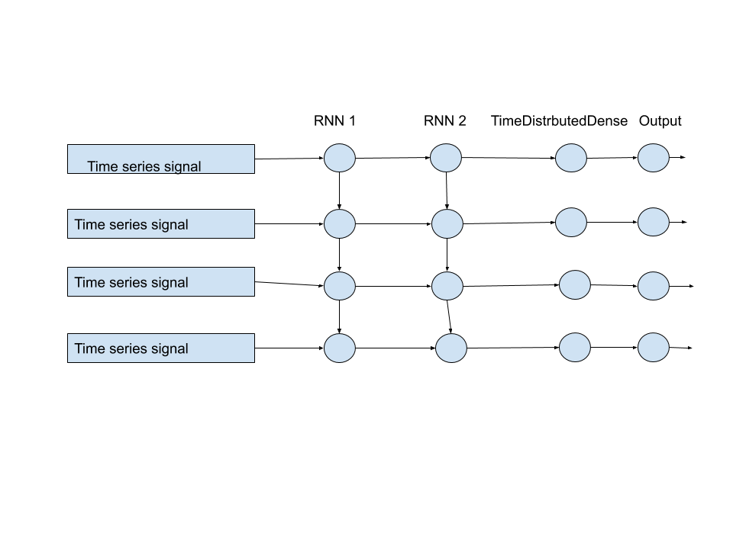
Deep RNN model

Slide 33
Deep RNN model
Components of the model-
Recurrent layer using GRU
Recurrent layer using GRU
BatchNormalization
TimeDistrbutedDense
Activation function
Training loss: 138.79
Validation loss: 139.8

Slide 34
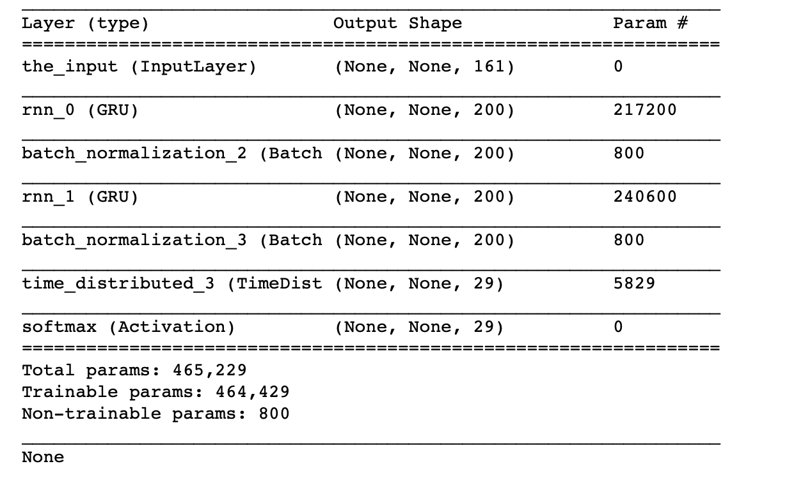
Deep RNN model

Slide 35
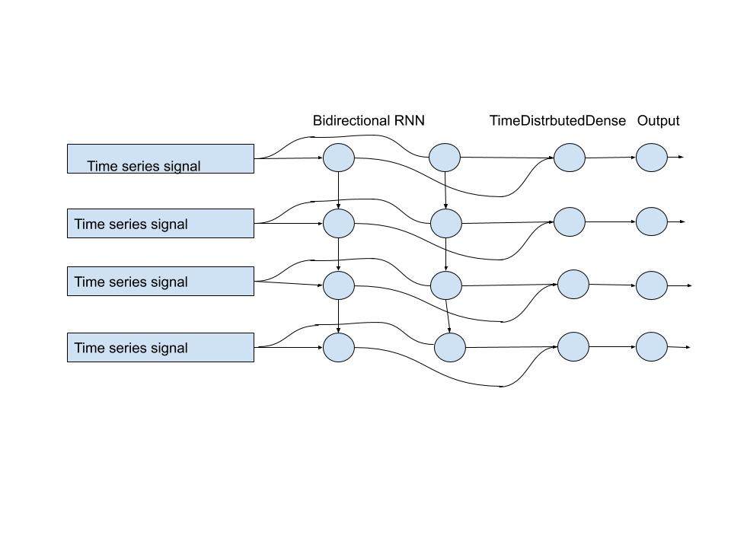
Bidirectional RNN model

Slide 36
Bidirectional RNN model
Components of the model-
Recurrent layer using GRU
Recurrent layer using GRU
BatchNormalization
TimeDistrbutedDense
Activation function
Training loss: 153.22
Validation loss: 171.97

Slide 37
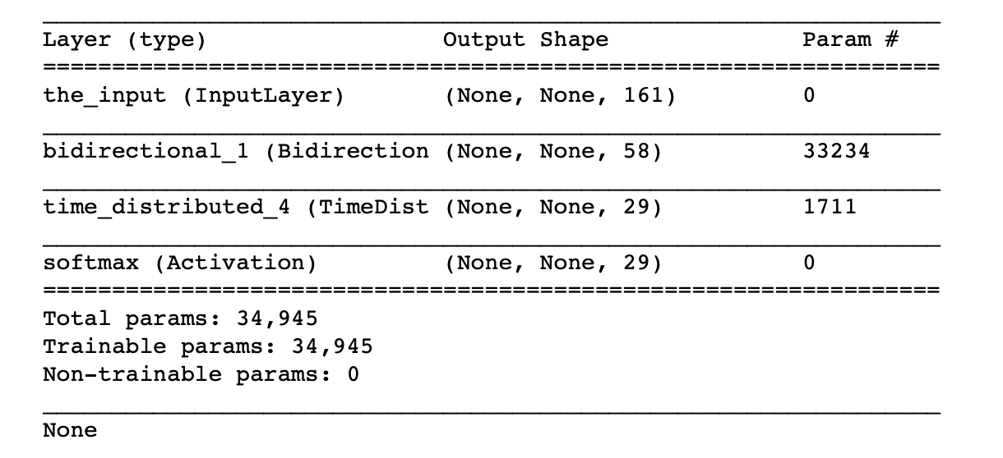
Bidirectional RNN model

Slide 38
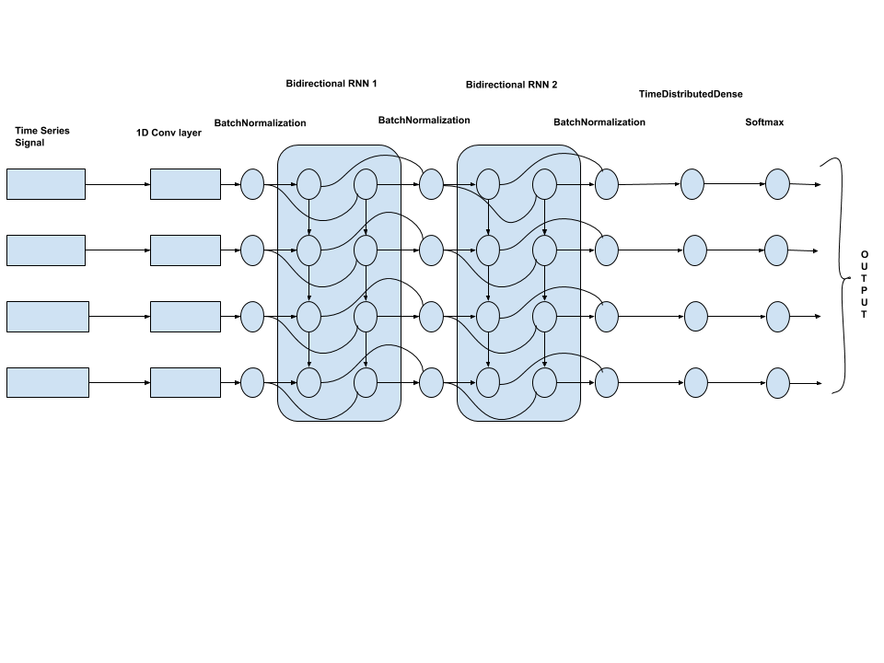
Our RNN Architecture

Slide 39
Our RNN Architecture
Components of the model-
1D convolutional layer
2 bidirectional Recurrent layers using GRU
BatchNormalization
TimeDistrbutedDense
Activation function
Training loss: 91.4
Validation loss: 117.0

Slide 40
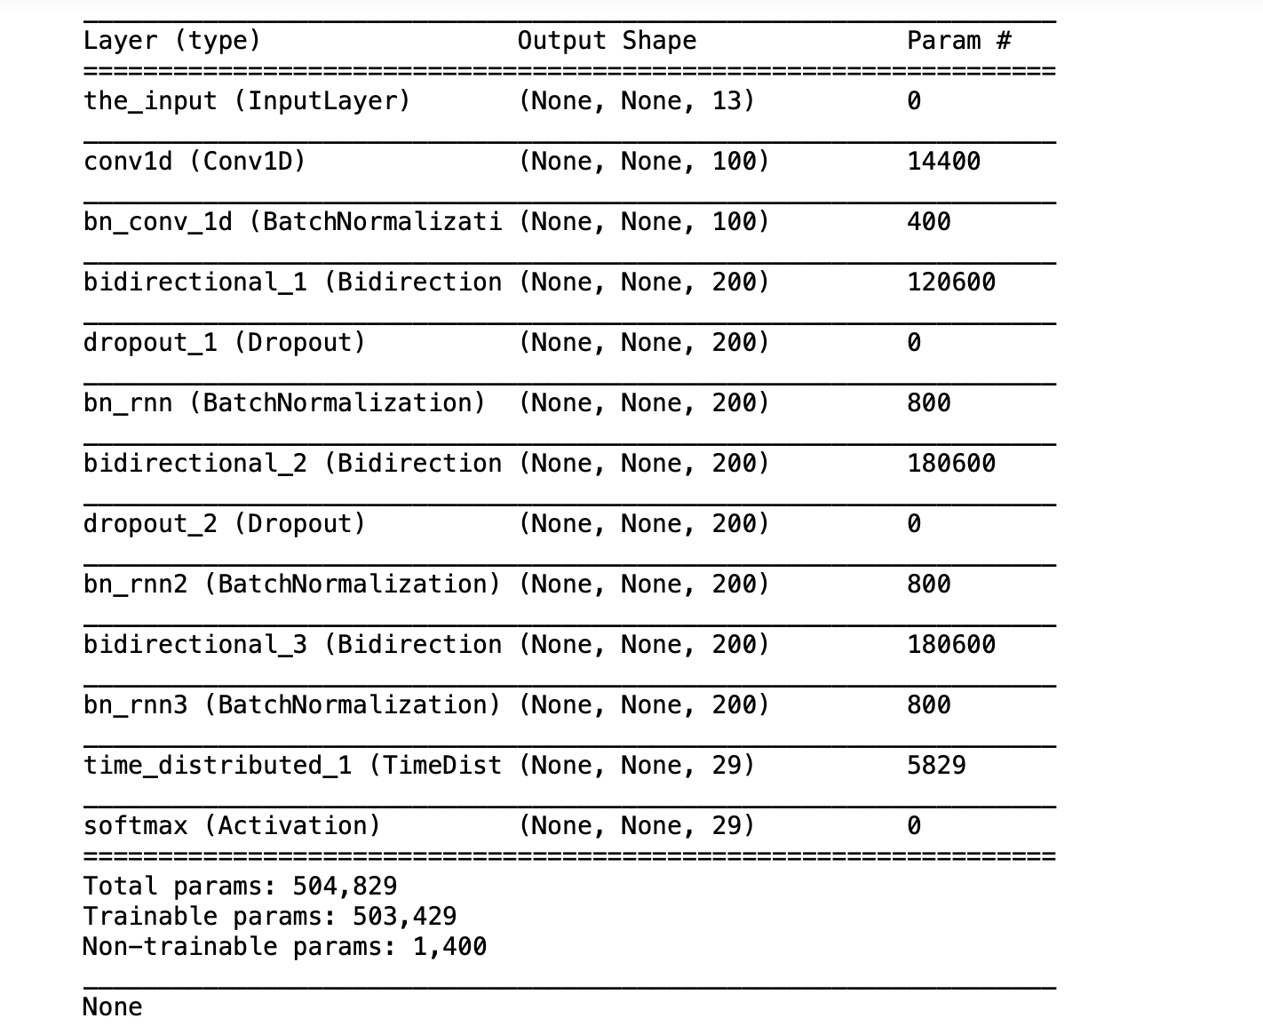
Our RNN Architecture

Slide 41
CTC Decoding
CTC decoding extracts the most likely vector from from Softmax probabilities
CTC decoding algorithm can compress the transcription to its correct length by ignoring adjacent duplicates and blanks

Slide 42
N-gram model
The need for N-gram model- RNN-CTC models do not perform well for getting the spellings of the predicted transcript text
Developed an n-gram model for correcting the spellings obtained from our final RNN model
The n-gram model corrected spellings of the obtained transcript text
Used TextBlob library’s in-built method to correct the spellings of final model output
Passed TextBlob library’s output as an input to n-gram model to get final corrected spellings.

Slide 43
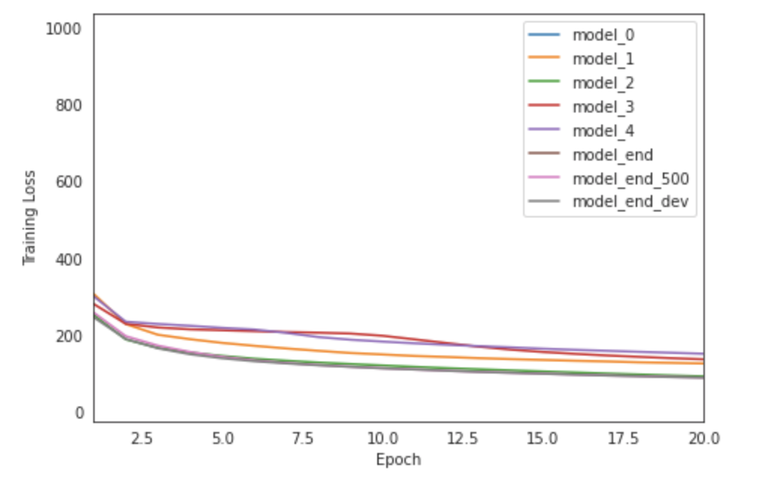
Results
Comparison of models using Training loss

Slide 44
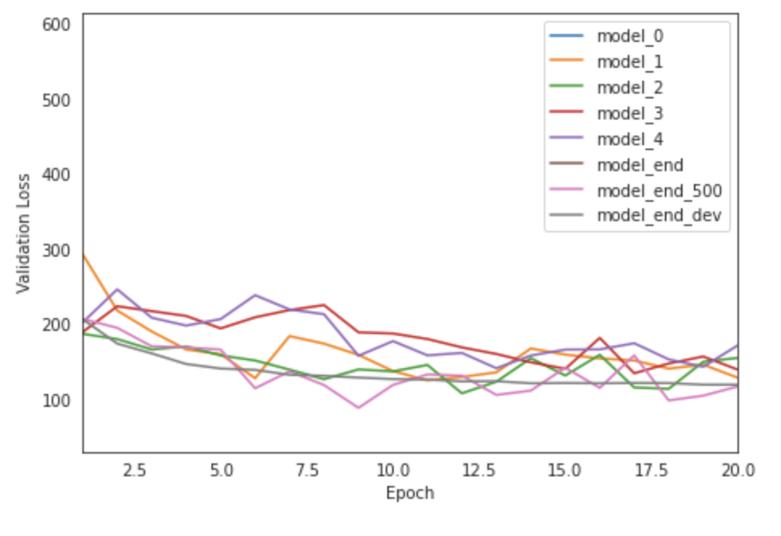
Results
Comparison of models using Validation loss

Slide 45
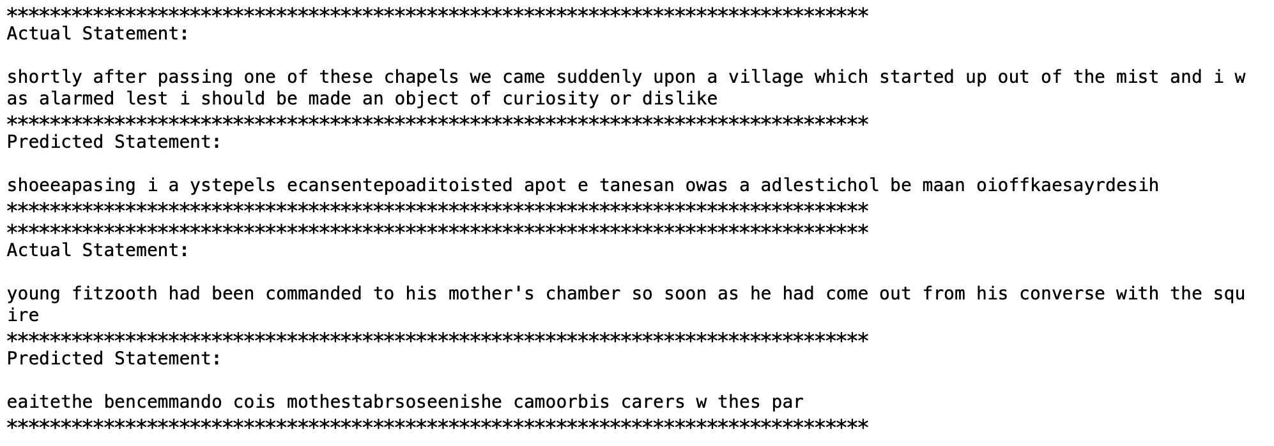
Results - Output ,Observations,tables of loss - compare
Sample outputs of the models
Model 0 gave blank output.
Model 1 output-

Slide 46
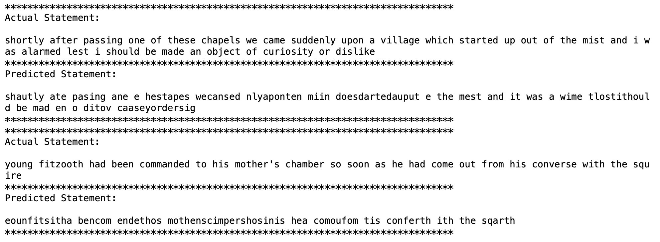
Output
Model 3 output-

Slide 47
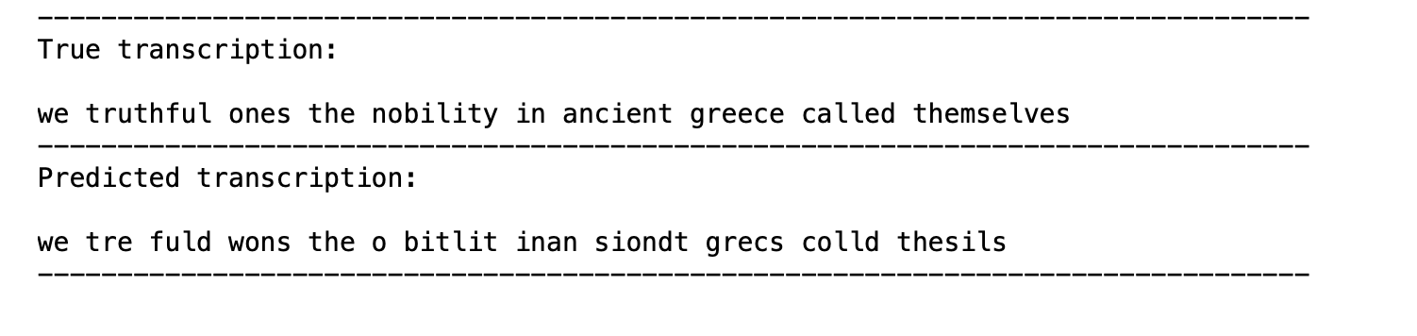
Output of our RNN architecture

Slide 48
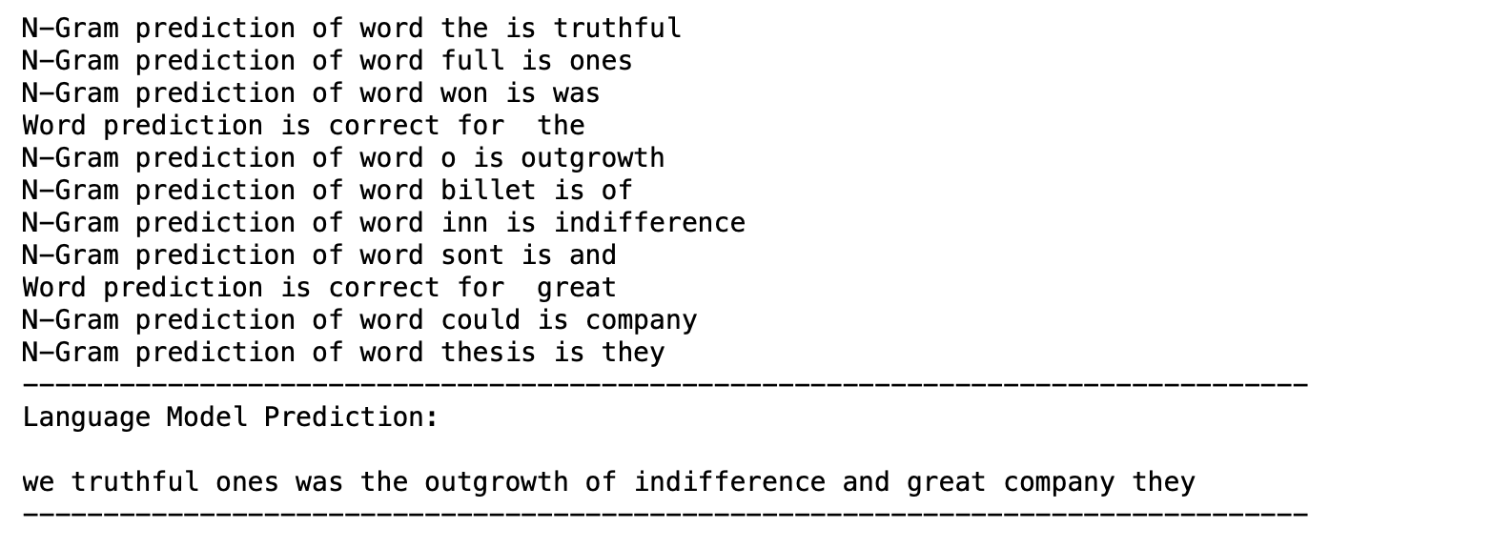
Output of our RNN architecture with n-gram

Slide 49
Best Model
In simple architectures, Deeper RNN model performed the best
Thus, used Deeper Bidirectional RNN architecture with a CNN layer
The final model that we made using all the above architectures performed the best
The minimum validation loss obtained was 117

Slide 50
Challenges Faced
RNN models took a lot of time to run
The time taken for training each of the model was almost similar irrespective of the complexity of the model
Vanishing gradients issue
Resolved using GRU and a gradient clipping method using clipnorm()

Slide 51
Conclusion
We implemented a Deep Learning based Speech Recognizer that would create transcripts given an audio
On comparison between Spectrogram and MFCC features, we found that Spectrogram features can be used for small dataset while MFCC features are generally used for large datasets for not overfitting and better generalization of the models
Use of multiple recurrent layers improves performance of the model
Integration of n-gram model with RNN-CTC models helped predict correct transcript text.
N-gram models improved the performance by spelling correction

Slide 52
Future
Can integrate Attention with the final model
Attention captures context of the words used
Using attention, the n-gram model result obtained can be improved.
More complex RNN architectures by adding more bidirectional recurrent layers

Slide 53
Some of the References...
[1]- “Mel scale,” 2020. https://en.wikipedia.org/w/index.php?title=Mel_scale&oldid=950711154 (accessed May 04, 2020).
[2]- “Spectrogram.” 2020, Accessed: May 03, 2020. [Online]. Available: https://en.wikipedia.org/w/index.php?title=Spectrogram&oldid=952207954.
[3]- LIBRISPEECH: AN ASR CORPUS BASED ON PUBLIC DOMAIN AUDIO BOOKS https://www.danielpovey.com/files/2015_icassp_librispeech.pdf
[4]- Deep Speech 2 : End-to-End Speech Recognition in English and Mandarin http://proceedings.mlr.press/v48/amodei16.pdf

Slide 54
Thank You!

